Slide 1
IT-331 ( Computer Graphics 1)
Lecture 5
Ellipse - Generating Algorithms
Dr. Mohammed El-Said
Assistant Professor, Computer Science Dept.,
Faculty of Computers & Artificial Intelligence,
Helwan University - Cairo, Egypt.

Slide 2
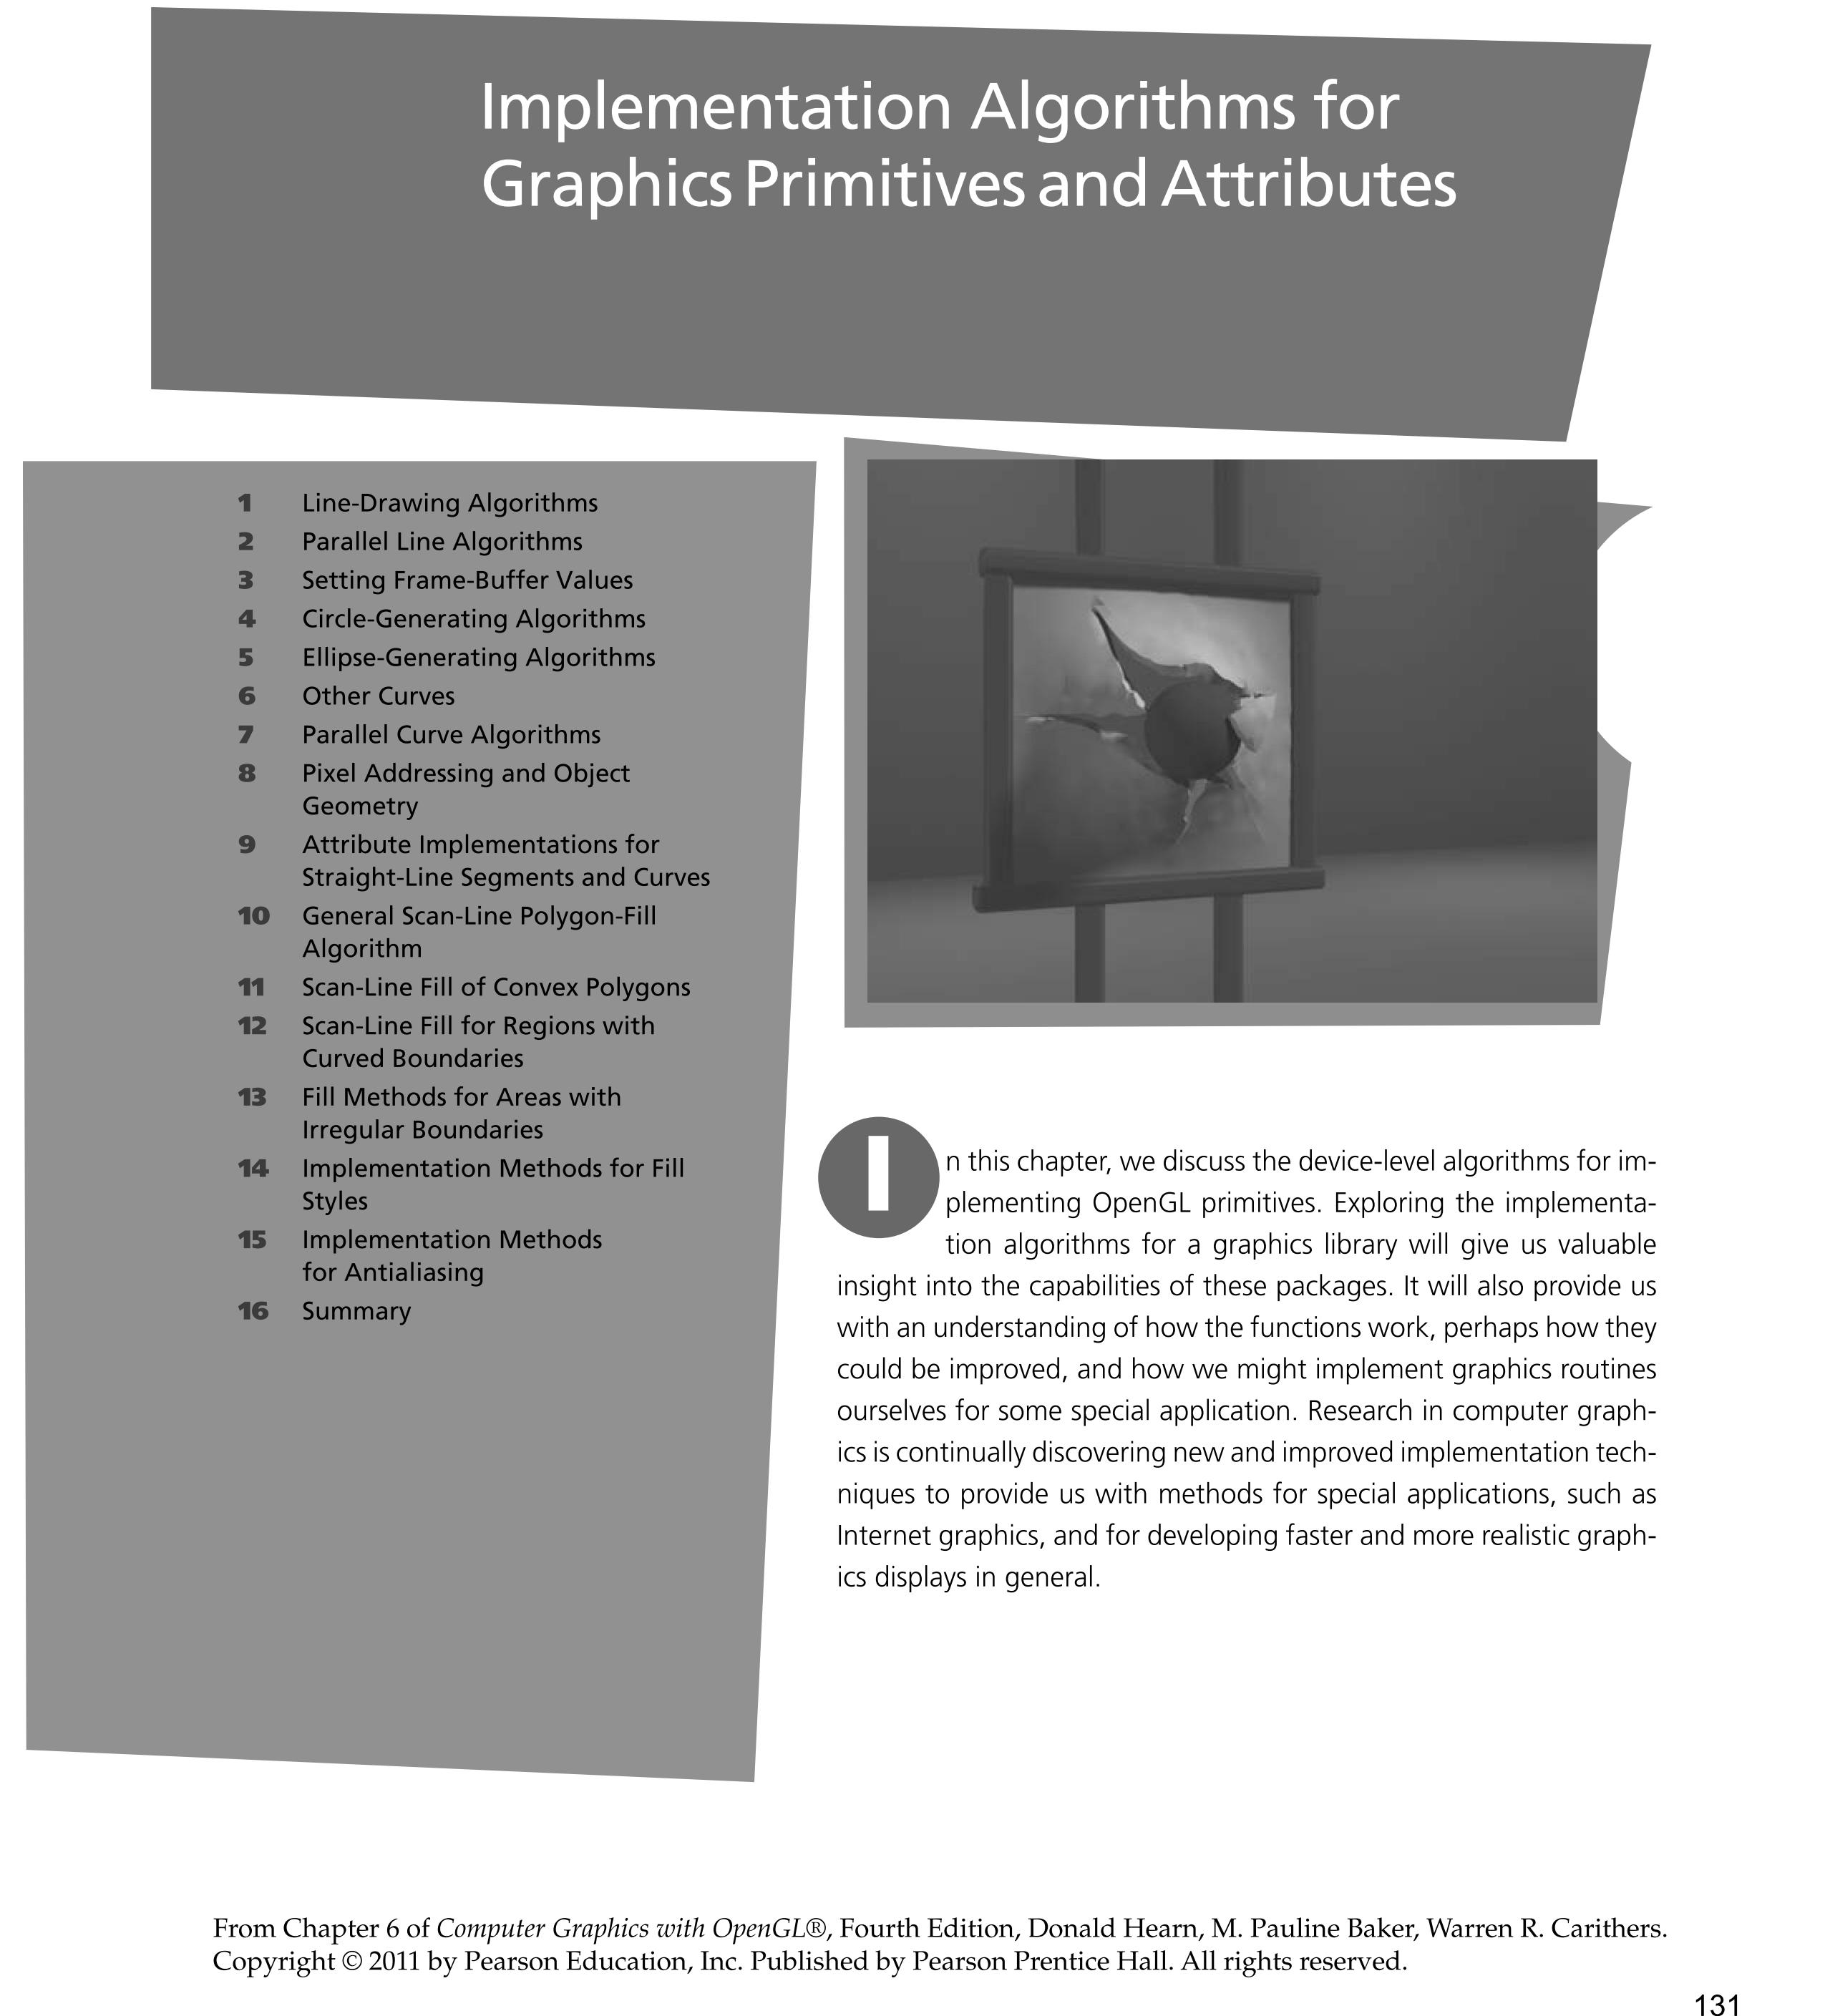

Slide 3
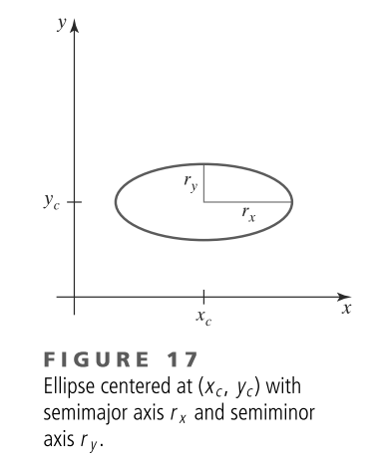
Ellipse-Generating Algorithms

Slide 4
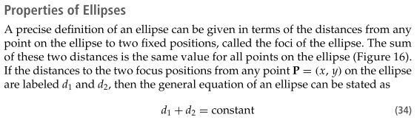
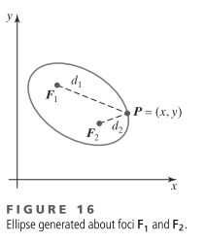
Ellipse-Generating Algorithms

Slide 5
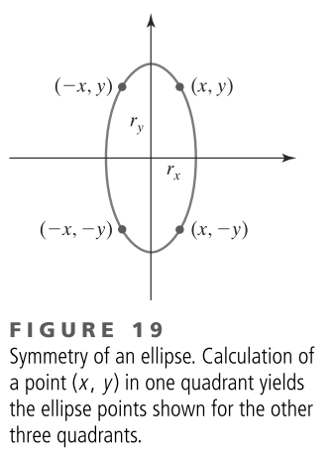
Midpoint Ellipse Algorithm

Slide 6
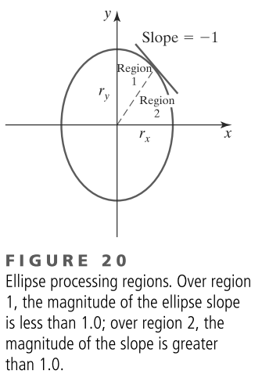
Midpoint Ellipse Algorithm

Slide 7
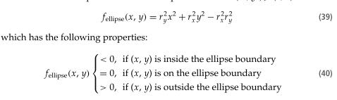
Midpoint Ellipse Algorithm

Slide 8
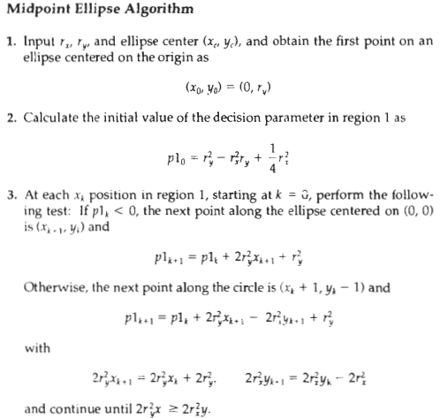

Slide 9
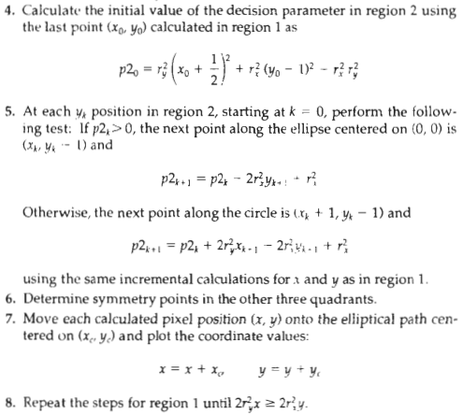

Slide 10
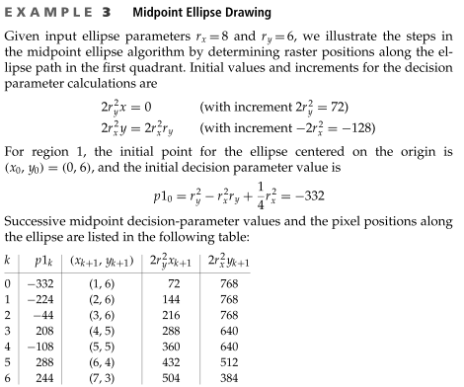
Midpoint Ellipse Algorithm

Slide 11
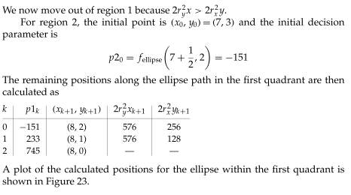
Midpoint Ellipse Algorithm

Slide 12
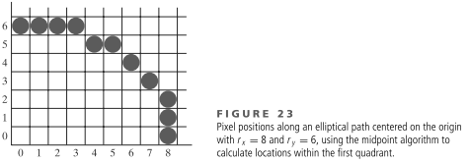
Midpoint Ellipse Algorithm

